Slide 1
Master Thesis
Ideas discussion

Slide 2
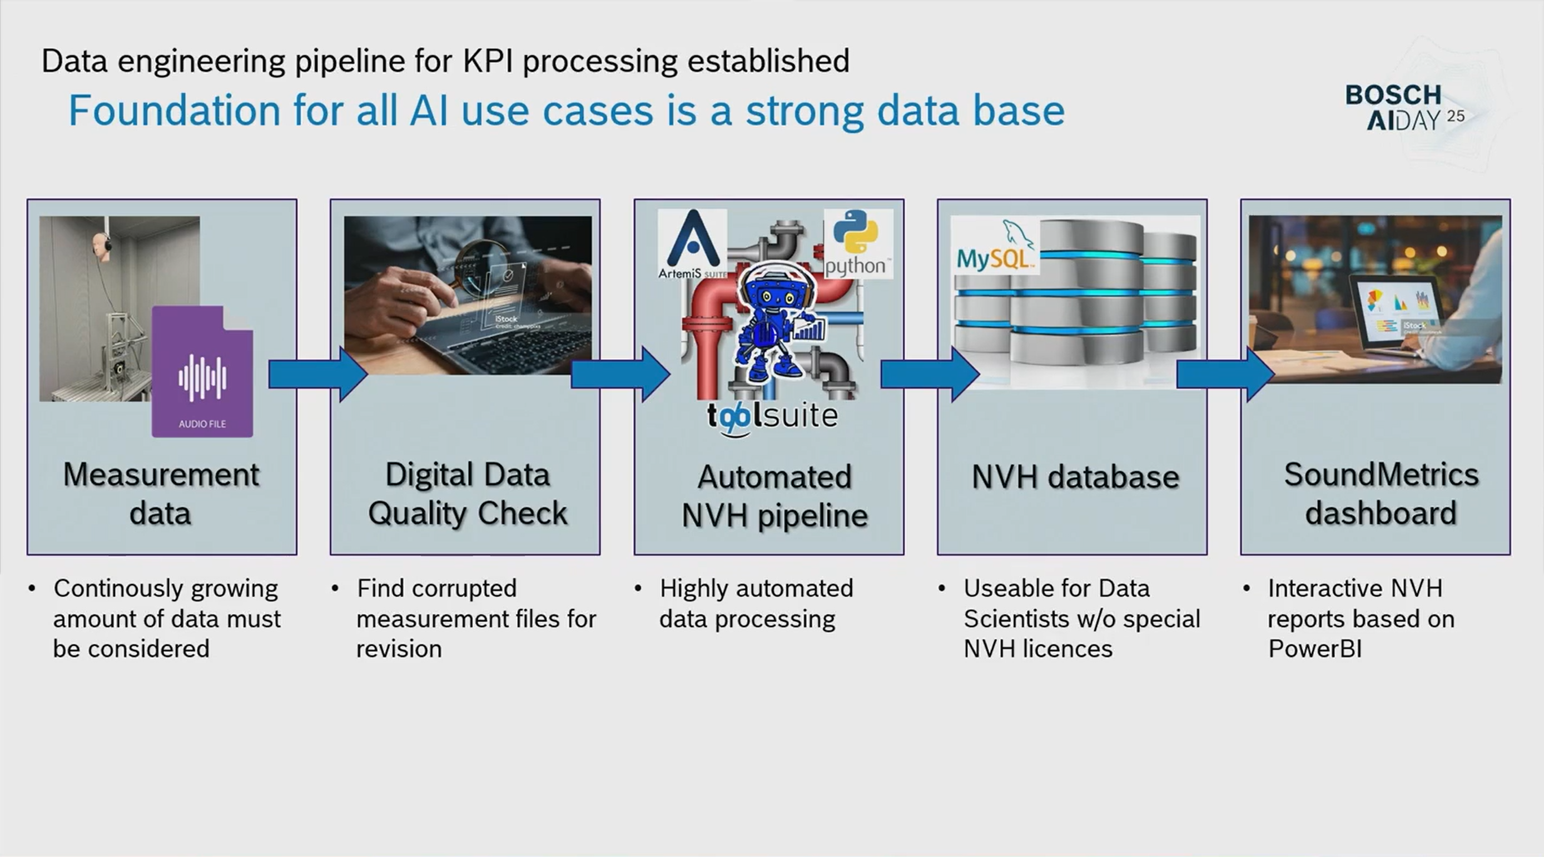
Current Architecture

Slide 3
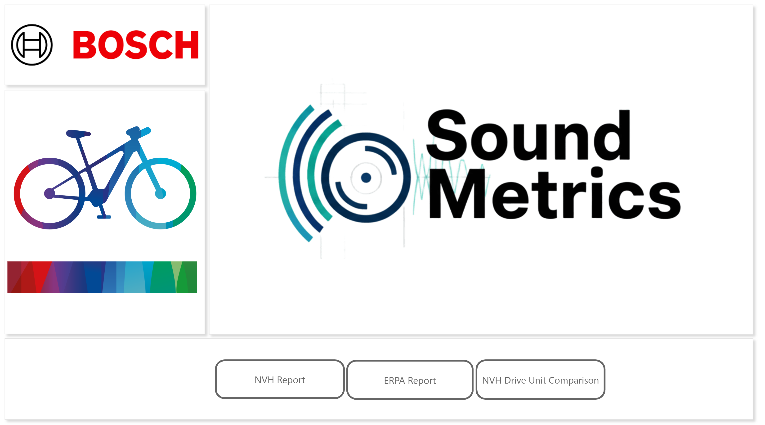
Output Reports

Slide 4
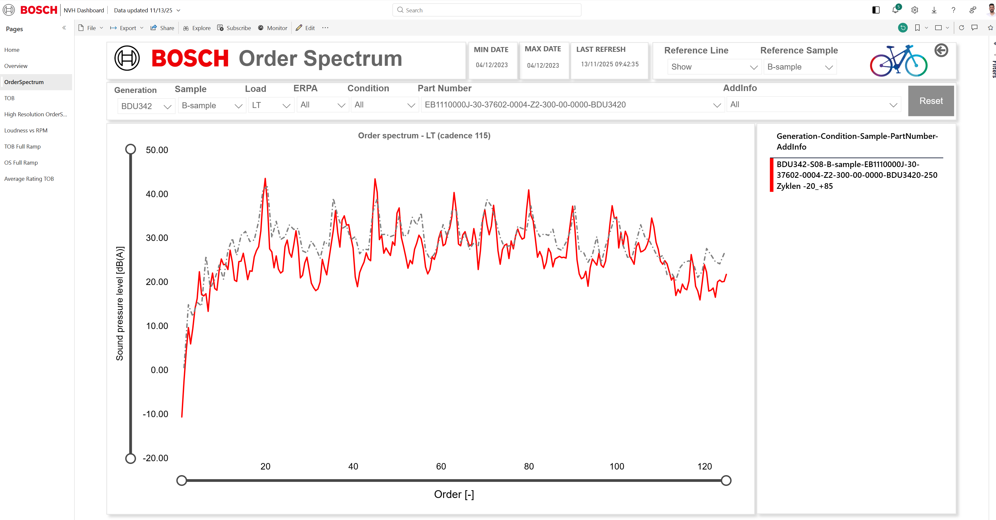

Slide 5
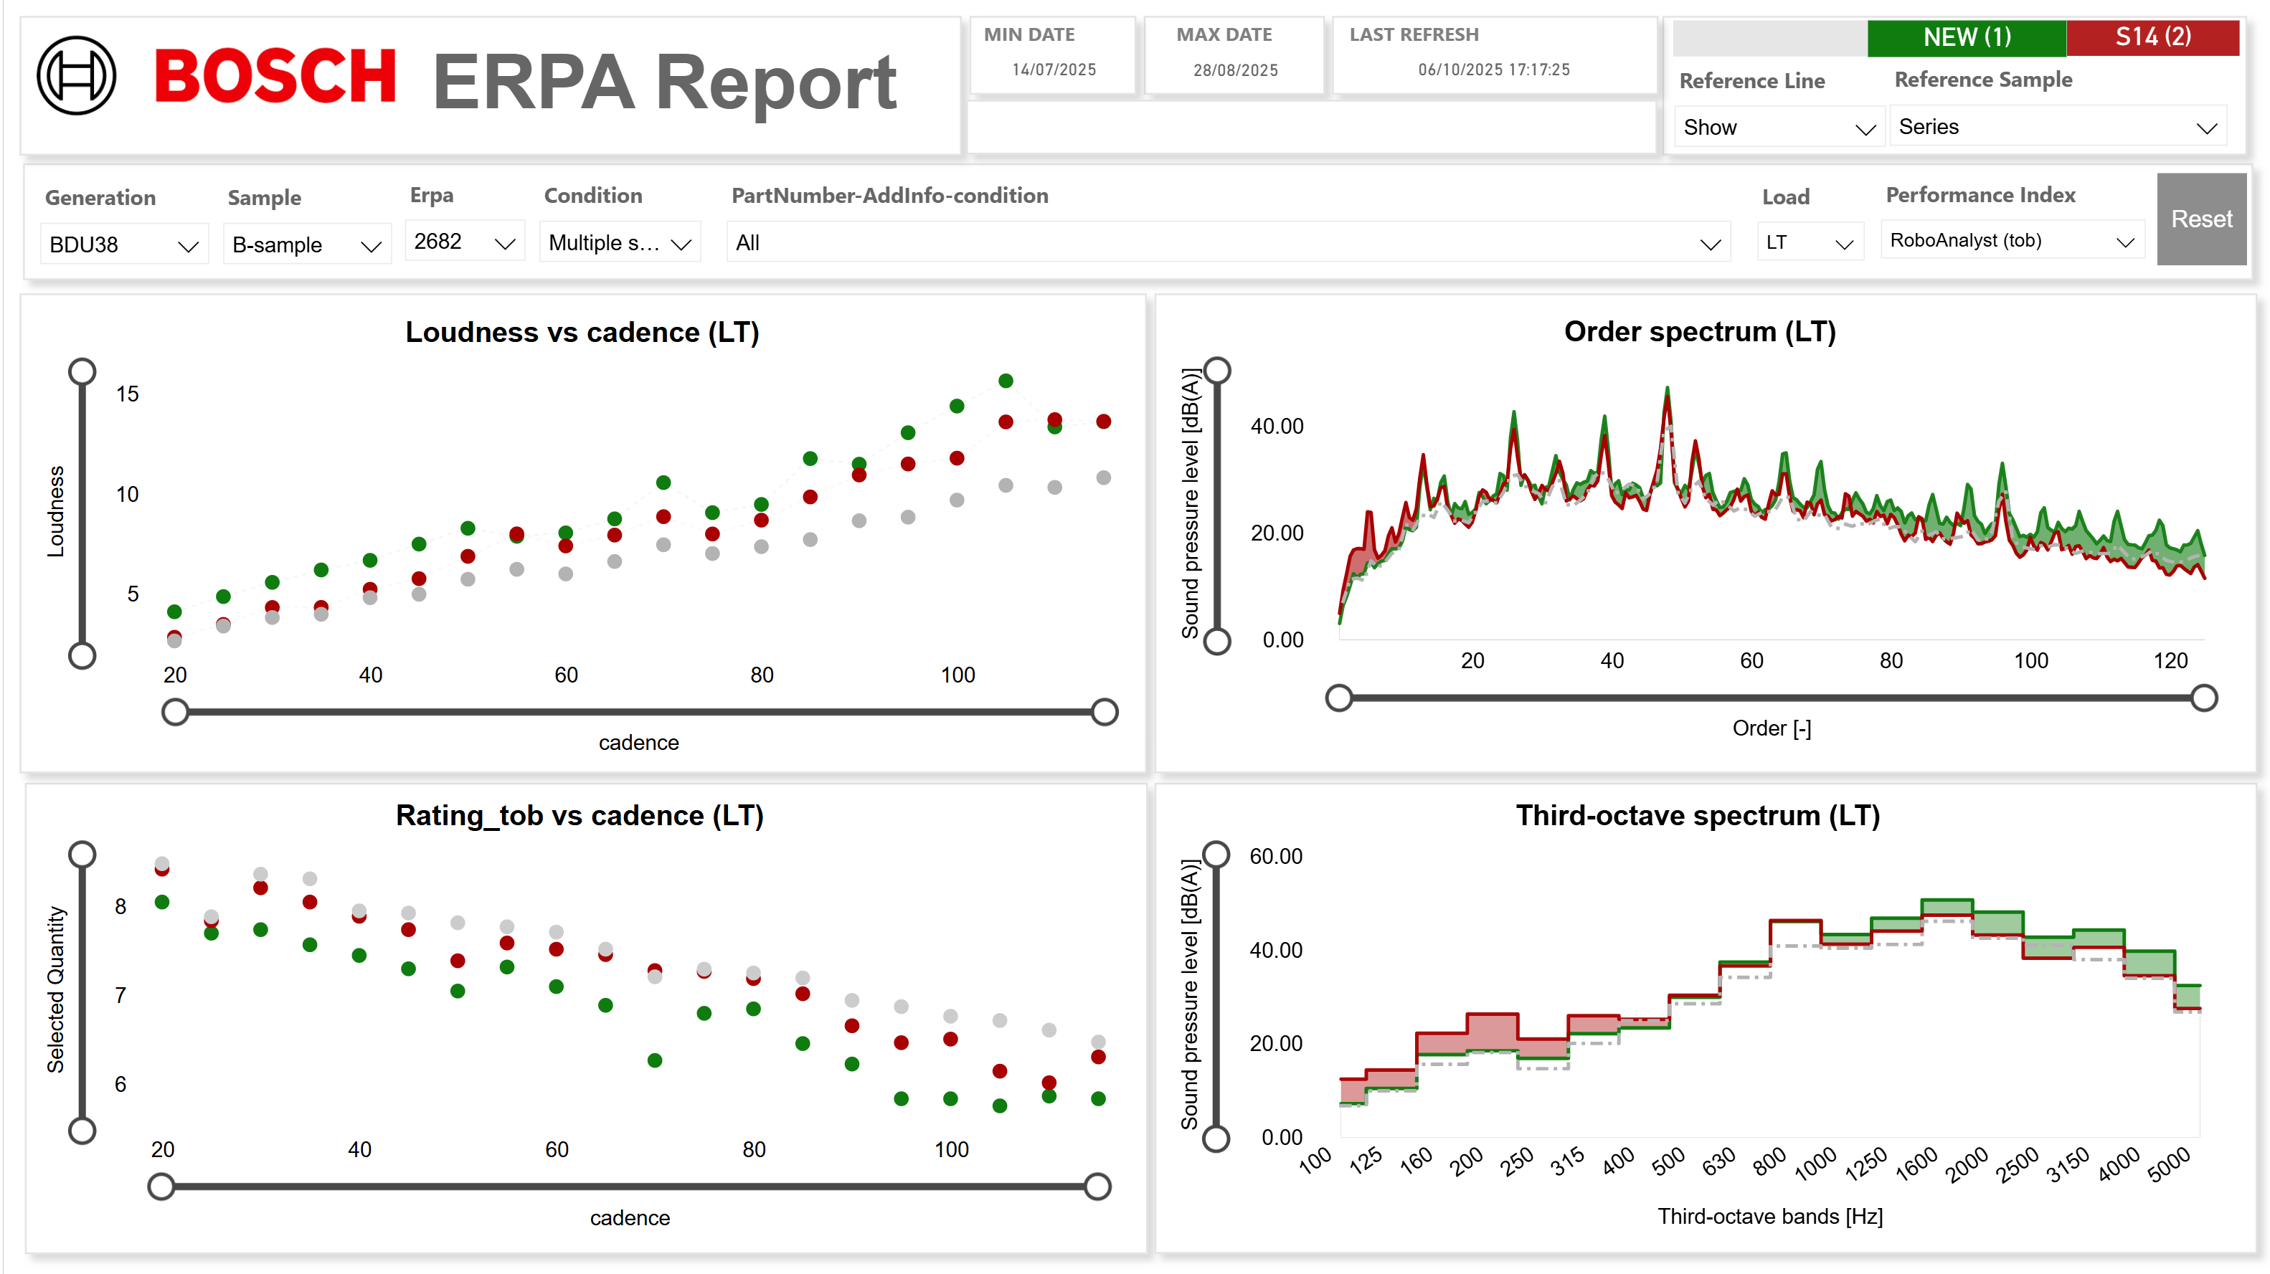

Slide 6
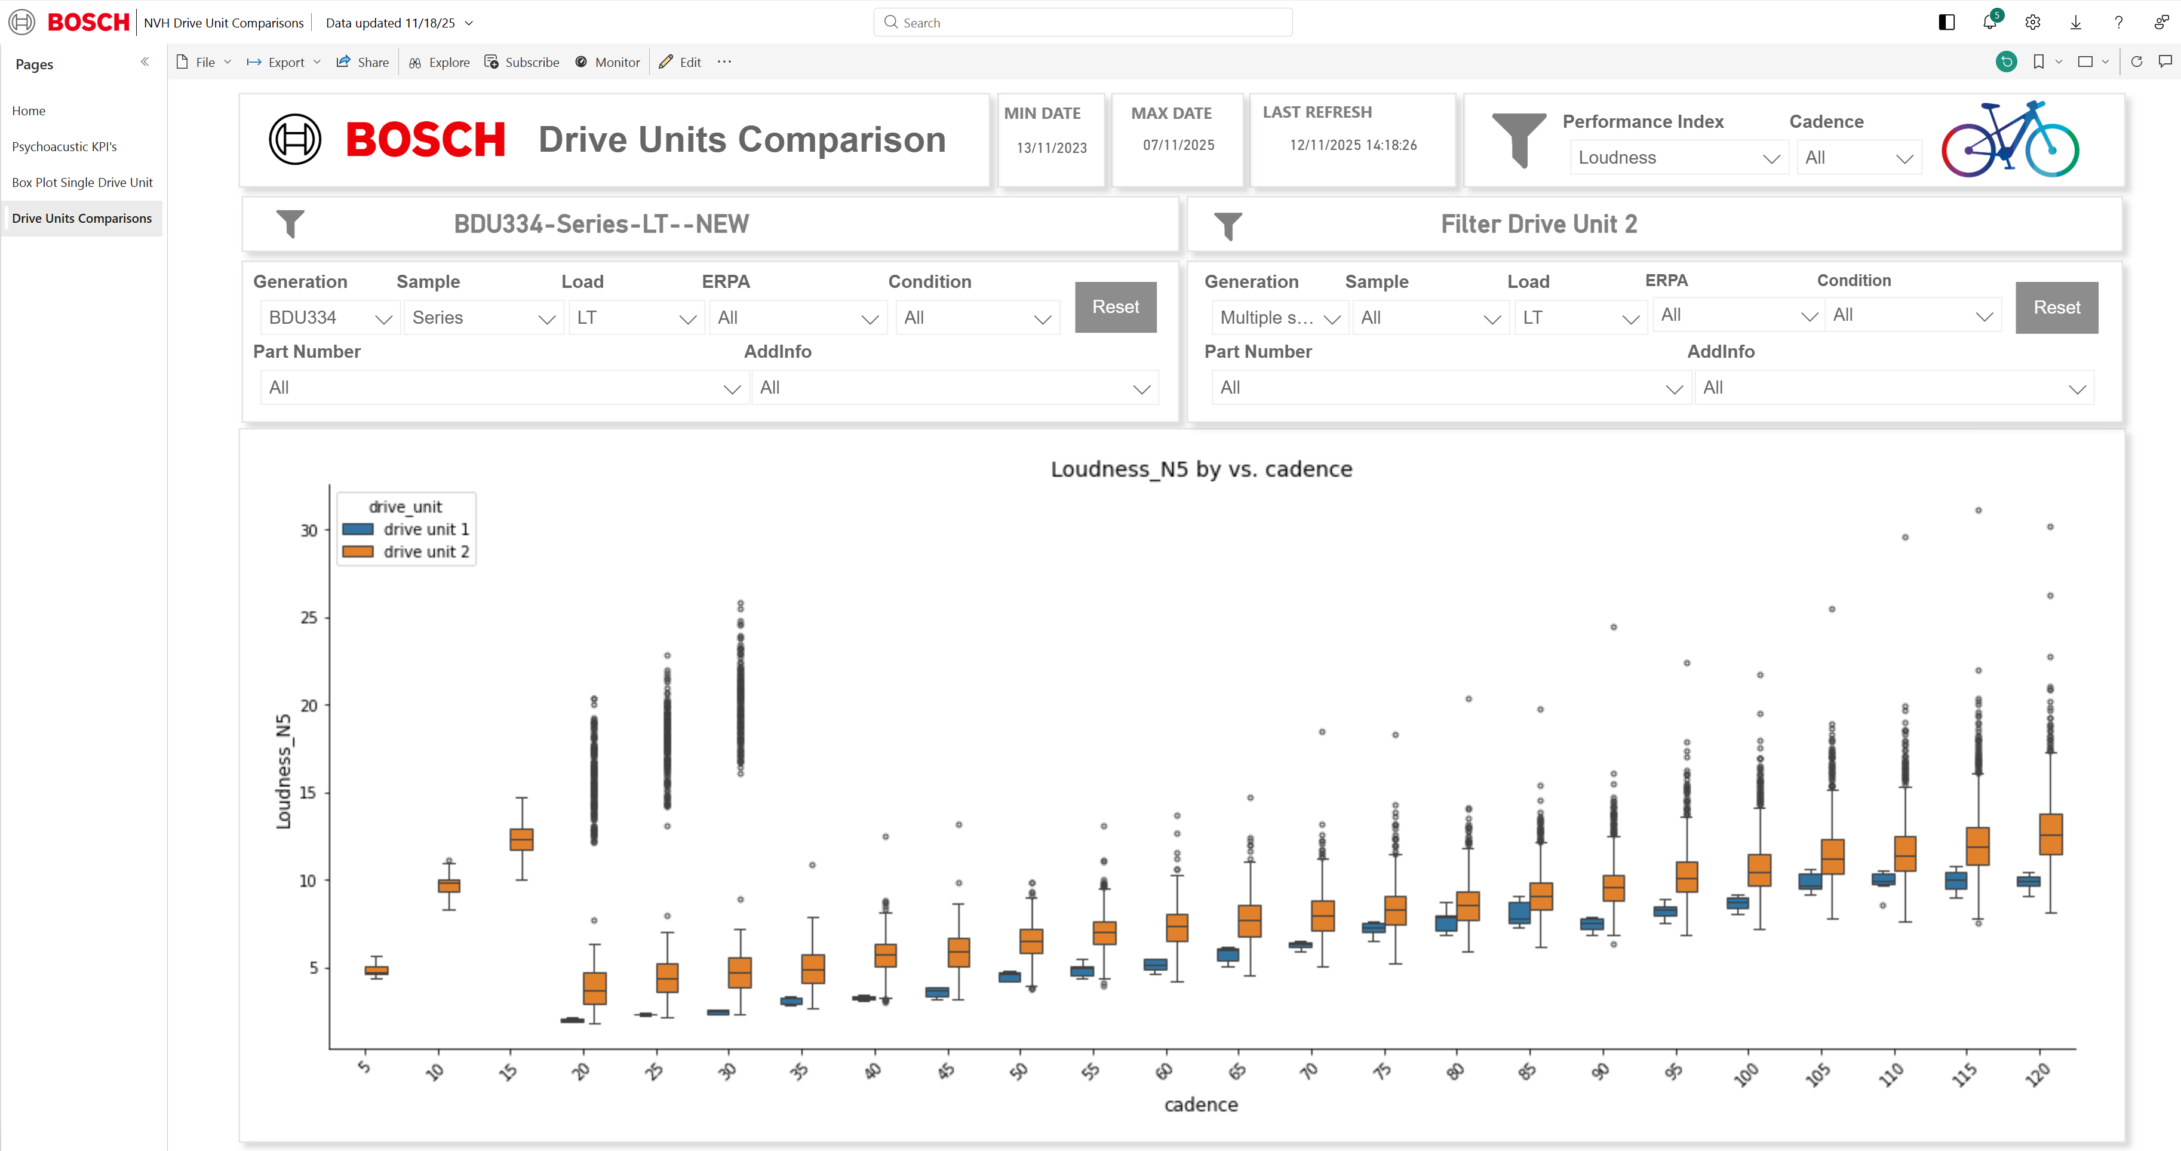

Slide 7
Possible topics
Topic 1 : Automate ETL pipeline
Currently : Batch Processing (ETL pipline executed every wednesday)
Idea : Automate the process and use spark streaming to process data in real time

Slide 8
Possible topics
Topic 2 : Integration of Power BI and Python
Currently : There are some limitations in Python visuals in Power BI for example no tool tips and visual quality
Idea : Develop a workflow to take filter values from Power BI and then display in Python Plotly

Slide 9
Possible topics
Topic 3 : Outlier detections using Machine Learning Models
Currently : There is no work done on this topic
Idea: Develop and implement machine learning–based techniques to automatically detect anomalies in the dataset, improving accuracy and reducing manual effort.

Slide 10
Thank You !

